Slide 1
Pizza sales analysis
Tools: sql ,powerbi

Slide 2
Project Overview
Objective: To analyze pizza sales revenue, identify trends, and provide insights to improve sales
Key insights:
Best selling pizza category: classic
Worst selling pizza category: chicken
Total revenue : $817860.05
Total pizza sold:49574
Total orders:21350
Average order value:38.31
Busy period: evening
Busy day :Friday

Slide 3
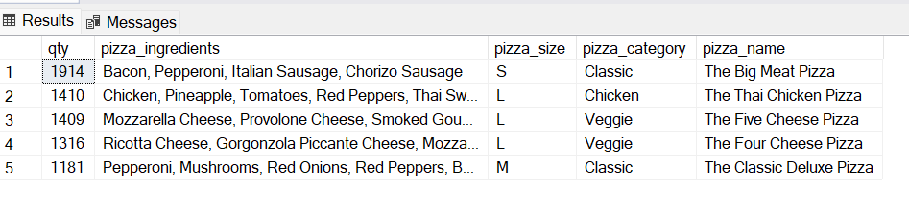
1.Top 5 selling pizza
select top 5 SUM(quantity) qty,pizza_ingredients,pizza_size,pizza_category,pizza_name from [Data Model - Pizza Sales]
group by pizza_ingredients,pizza_size,pizza_category,pizza_name
order by qty desc;

Slide 4
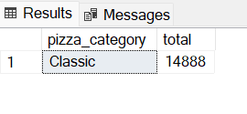
2. most selling pizza
select top 1 pizza_category,sum(quantity) total from [Data Model - Pizza Sales]
group by pizza_category
order by total desc;

Slide 5
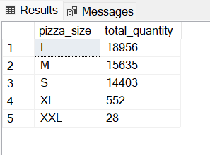
3.Pizza sales quantity based on sizes
select pizza_size,SUM(quantity) as total_quantity from [Data Model - Pizza Sales]
group by pizza_size
order by total_quantity desc;

Slide 6
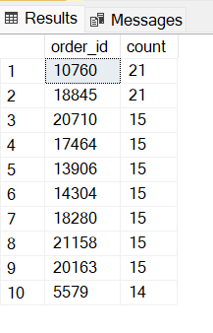
4.Top 10 order id
select top 10 order_id,count(pizza_id) count from [Data Model - Pizza Sales]
group by order_id
order by count desc;

Slide 7
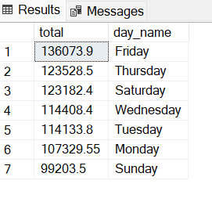
5.Total sale on weekday basis:
select round(sum(total_price),2) as total , DATENAME(WEEKDAY,order_date) as day_name from [Data Model - Pizza Sales]
group by DATENAME(WEEKDAY,order_date)
order by total desc

Slide 8
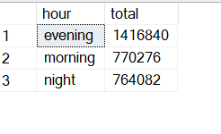
6.Total quantity sold on time basis:
select hour,ROUND(sum(total_price),0) total from(
select
case
when DATEPART(hour,order_time) between 9 and 12 then 'morning'
when DATEPART(hour,order_time) between 13 and 17 then 'evening'
when DATEPART(hour,order_time) between 18 and 24 then 'night'
end as hour, order_id
from [Data Model - Pizza Sales])
as new_table join [Data Model - Pizza Sales] on new_table.order_id=[Data Model - Pizza Sales].order_id
group by hour
order by total DESC;

Slide 9
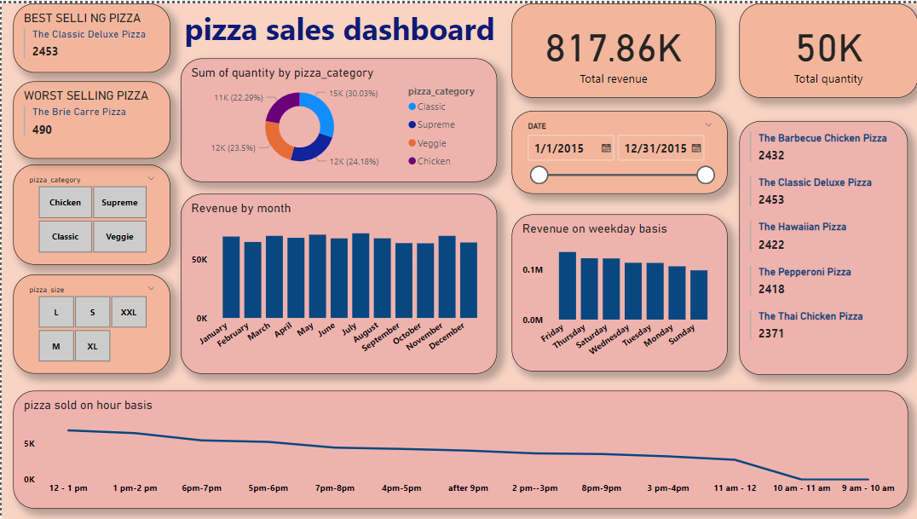
PIZZA SALES DASHBOARD

